Slide 1
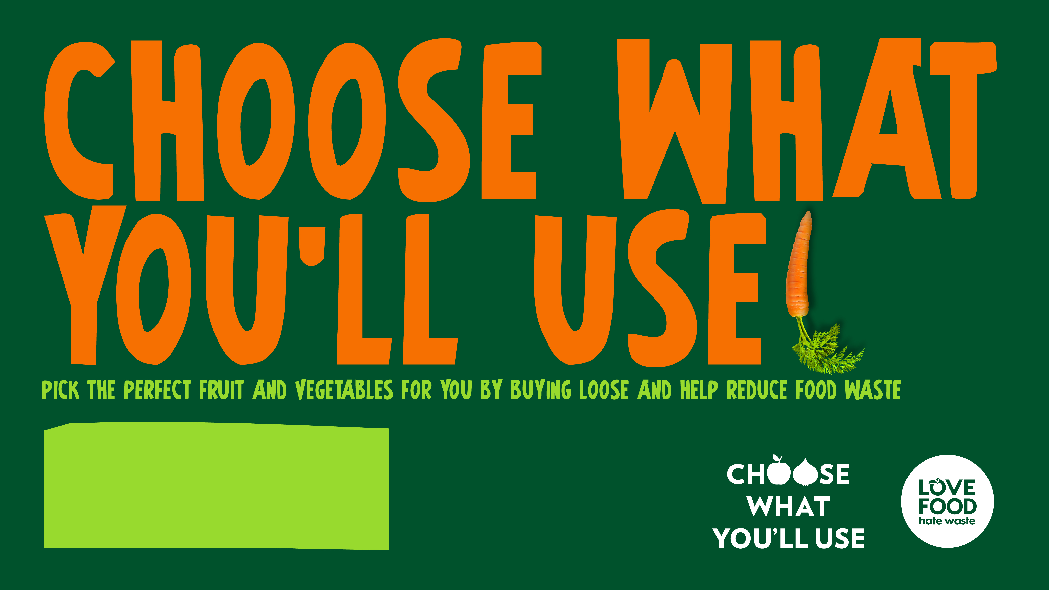
Subject: PSHE, Health Education, Computing
Time: Approx. 45 minutes

Slide 2
About Choose What You'll Use
      ​Overview
      Choose What You'll Use, from Love Food Hate Waste, is a free-to-use teaching resource for schools.
      This session is designed to empower pupils to explore food waste and the power of loose fruit and vegetables. You can deliver this as a lesson, or parts of it as a whole-school assembly.
      Key information
      Age: 7-11
      Time: 45 minutes
      Subject: PSHE, Health Education, Computing
      Resources:
      Story challenge worksheets (one per pupil)
      Food waste shopping list worksheet (optional, one per pupil)
      Web page challenge worksheets (optional, one per pupil)
      A range of fruit and vegetables (optional)
      Preparation:
      Review this presentation and adapt to meet your pupils' needs.
        Developed by experts
        This programme has been developed in partnership with Hark London and a panel of subject matter experts and practising teachers.
        Using this presentation
        Teachers' notes slides will not display in presentation mode.
        Slide notes contain further teacher guidance, including sample answers.
        Links to external websites
        Please follow your school’s own internet safety guidelines.

Slide 3
Lesson overview
      ​Learning objective: To understand why food waste is a problem and how we can reduce it by choosing what we'll use.
Activity | Slides | Overview | Timings | Preparation and resources required
Starter | 6-7 | Pupils hear the story of Lana the banana and learn that lots of fruit and vegetables go to waste when we buy too much at once. They review the learning objective and learning outcomes for the lesson. | 10 mins | Optional, a banana in a bag to bring the story to life.
Introduction | 8-14 | Pupils explore how food can go to waste and why wasted food is bad for our environment and climate, as well as being a waste of money. | 15 mins
​Activity | 15-17 | Pupils write their own story about a fruit or vegetable their family enjoys, showing how when we Choose What We'll Use, we waste less food. | 20 mins | Story challenge worksheets, one per pupil. Optionally, a range of fruit and vegetables to help pupils choose.
Plenary | 18-19 | Pupils read Lana's happy ending and how the Wilson family learn to Choose What You'll Use. They are encouraged to take their stories – and the message – home to their families. | 5 mins | Food waste shopping list worksheet, one per pupil.
        ​There is also an optional extension activity to create a web page to share pupils' stories and messages about avoiding food waste (slides 20–21). Use the Web page challenge worksheets to support this activity.

Slide 4
Curriculum links
      ​England
      Health education
      By the end of primary school, pupils should know:
      what constitutes a healthy diet
      the principles of planning and preparing a range of healthy meals.
      PSHE
      KS2
      H1. how to make informed decisions about health
      H2. about the elements of a balanced, healthy lifestyle
      H6. about what constitutes a healthy diet; how to plan healthy meals; benefits to health and wellbeing of eating nutritionally rich foods
      L5. ways of carrying out shared responsibilities for protecting the environment in school and at home; how everyday choices can affect the environment (e.g. reducing, reusing, recycling; food choices)
      Northern Ireland
      The World Around Us
      pupils should be enabled to explore how waste can be reduced, reused or recycled and how this can be beneficial.
      Personal Development and Mutual Understanding
      being aware of how to care for his/her own body in order to keep it healthy and well, for example, by talking about which foods are healthy.
Citizenship​ - Preparing to play an active role as citizens
​a. to research, discuss and debate topical issues, problems and events
j. that resources can be allocated in different ways and that these economic choices affect individuals, communities and the sustainability of the environment
Ofsted School inspection handbook - Personal development
The school develops pupils to become responsible, respectful and active citizens who are able to play their part and become actively involved in public life as adults.
Promoting fundamental British values as part of SMSC in schools
Through their provision of SMSC, schools should encourage students to accept responsibility for their behaviour, show initiative, and to understand how they can contribute positively to the lives of those living and working in the locality of the school and to society more widely.
Unicef Level 1 Rights Respecting Schools Award
Children and young people are beginning to see themselves as rights respecting global citizens and advocates for fairness and children’s rights locally and globally.

Slide 5
Curriculum links
      ​Scotland
      Health and wellbeing (food and health)
      I enjoy eating a diversity of foods in a range of social situations. HWB 2-29
      When preparing and cooking a variety of foods, I am becoming aware of the journeys which foods make from source to consumer, their seasonality, their local availability and their sustainability. HWB 2-35a
      Social studies
      I can discuss the environmental impact of human activity and suggest
      ways in which we can live in a more environmentally-responsible way.
      SOC2-08a
      Wales
        Humanities progression level 3
        I can describe and give simple explanations about the impact of human actions on the natural world in the past and present.
        I can understand the consequences of my actions and the actions of others, and how these affect my locality and Wales, as well as the wider world.
        I have planned and taken an active role in response to challenges and opportunities in my local community, or in Wales or the wider world, and I have done so individually or as part of a team.
        Health and well-being progression level 3
        I can make considered decisions, taking into account available information, including past experiences.
        I can recognise that some decisions I make will have a long-term impact on my life and the lives of others.
        I can understand that decisions can be made individually and collectively, and that they can be influenced by a range of factors.

Slide 6
  Lana grew from a tiny bulb to an impressive fruit in Costa Rica, Central America. Lana was used to a warm, tropical climate, so it was a bit of a shock when she was packed into a refrigerated ship bound for the UK!
  She was surprised to be wrapped in a plastic bag with six of her friends, but excited when the Wilson family bought her bag and gave it pride of place in their fruit bowl. She looked forward to sharing her delicious, vitamin-packed goodness with one of the Wilsons!
  As each day passed, Lana's banana friends made their way into Isla Wilson's lunchbox, but Lana began to lose hope – she was starting to get brown and mushy! One day, a fresh bag of bananas appeared in the fruit bowl on top of Lana. A few days after that, Mr Wilson found Lana in her bag and picked her up. Finally! Had her moment come?
  “What shall we do with this?’ Mr Wilson asked Isla, wrinkling his nose. “We can't eat this now, can we?”
  Lana held her breath. What would become of her?
Notes:
Delivery notes
Read the story on the slide to the class.

Slide 7
Like Lana, lots of fruit and vegetables go to waste – especially when they are bought in a bag but not used in time.
What do you think the Wilson family can do differently,
to stop fruit and vegetables like Lana the banana from going to waste?
Notes:
Delivery notes
Discuss as a class, in pairs or small groups.
Sample answers
What could the Wilsons have done differently?
They knew that Isla wanted a banana every day in her school packed lunch – they could have bought five individual bananas instead of a pack of six (this also saves on packaging!)
If they did buy the pack of six, one of the other people in the family could have eaten Lana instead of buying a different snack, or they could have used her up in another way (Lana would taste good with natural yogurt, custard or ice cream as a dessert, or made into banana bread or a pancake filling, for example).

Slide 8
Learning objective ​
To understand why food waste is a problem and how we can reduce it by choosing what we'll use.
Learning outcomes
I can: ​
explain how food waste is bad for our environment as well as a waste of money
explain how when we choose what we'll use, we buy only what we need and prefer, saving money and reducing waste
give examples of the choices people have when shopping to select the size, quantity, colour and ripeness of fruit and vegetable that is right for them and their needs.
Notes:
Delivery notes
Read the learning objectives and outcomes. Explain that some questions at the end of the lesson will help pupils to reflect on their learning.

Slide 9
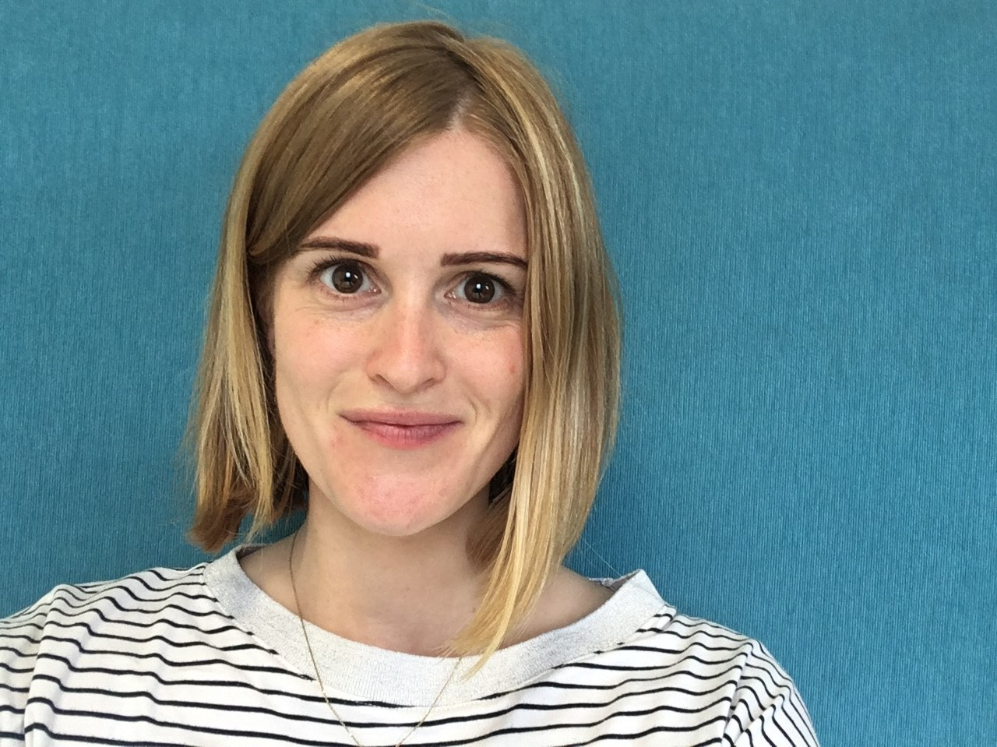
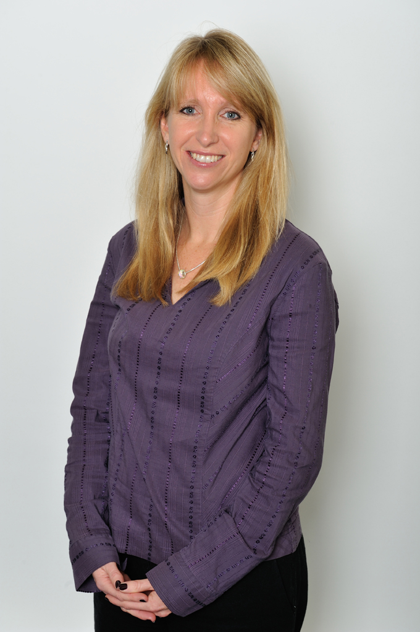
Help us to help everyone to Choose What You'll Use!​
Harriet
Jackie
We need you to help us!
Our latest campaign is
Choose What You'll Use
First, we need to tell you a bit more about food waste.
Harriet and I are campaign managers on the Love Food Waste campaign – it's our job
to help everybody to understand how we can reduce
food waste.
Notes:
Delivery notes
Share the information in the speech bubbles.
Ask pupils what they think food waste is.

Slide 10
How do we let food go to waste?
Every bit of the food we buy has value – and we waste that value if we don't eat the food.
How could these people change their behaviour to make sure their fruit and vegetables
don’t end up like Lana the banana?
“I don't remember to look at what I have before I go shopping. Then I buy things I already have and end up with too much.”
“My fridge, freezer and cupboards are a mess! I often find food at
the back that's gone off.”
“I don’t plan my meals. I just grab what looks nice in the shops
and work out what to eat as I
go along.”
“I know what I need for the meals I've planned, but I don't work out how much – I often end up with more than I need.”
Notes:
Delivery notes
Run through these speech bubbles then ask pupils to work in pairs or small groups to come up with solutions.
For example:
Keep your kitchen storage tidy so you know what you have, and keep things that need to be used first at the front.
Plan what you'll eat and write a shopping list.
Before you shop, check what you already have.
Before you shop, work out (or read from the recipe) how much you'll need of each item or ingredient, so you only buy what you need.

Slide 11
Why is food waste a problem?
When waste food breaks down,
it releases greenhouse gases that contribute to climate change.
A lot of energy and water is used to produce food, so when we throw food away, all that energy and water is wasted too.
Wasting food isn't just bad for our pockets, it's bad for our planet.
When food goes to waste, it's a
waste of money, and of the
valuable nutrition in that food.
Did you know?
In the UK, we throw away about 4.7 million tonnes of edible food waste each year.
That's worth £17 billion – or £80 a month
for the average family with children.
Food waste contributes about 8-10% of the world's man-made greenhouse gas emissions.
If global waste food was a country, it would be the world's third largest emitter of greenhouse gases, after China and the USA.
Notes:
Delivery notes
Read the information on the slide. You may wish to discuss what pupils already know about how climate change is already affecting people around the world, including in the UK.

Slide 12
Ways to avoid waste
Before you shop
Plan your meals and snacks for
the week.
Make a list, including what you’ll
need and how much.
At the shop
Choose What You'll Use!
Back at home
Store food safely to stop it going off.
Keep your cupboards, fridge and
freezer organised, so you can easily
see what you have.
Did you know?
If your area offers food waste recycling, you can get even more out of your food by recycling inedible food waste like banana peel or eggshells!
Did you know?
All fruit and vegetables (except bananas, pineapples and onions) should be stored in the fridge as they will last weeks, and sometimes months, longer!
Notes:
Delivery notes
Allow pupils to share their ideas, then click to reveal our sample answers.
Support: define inedible food as food that cannot be eaten.

Slide 13
Choose What You'll Use!
Loose fruit and vegetables are the best you can buy because you can choose only the items that are right for you!
.. and you're also helping the environment because you're not buying them in plastic packaging!
What's right for you?
How many potatoes does your family eat in a week?
How many apples do you enjoy at lunchtime?
Do you like a ripe banana, or one that's still a bit green?
Do you prefer a large orange, or a small satsuma?
The Food Portion Calculator can help you work out exactly how many fruit and vegetables you need to buy each week (or for each meal).
Do you like softer fruits, or ones that have a little crunch?
Notes:
Delivery notes
Run through the information on the slide.
Use the questions to help pupils explore the choices they have when they buy loose fruit and vegetables, for example quantity, size, ripeness, colour or texture.

Slide 14
Help us to help others – and our planet!
Jackie
Harriet
Now you know more about
the problem of food waste and our Choose What You'll Use campaign, you're ready to
help us!
We need you to put your communications skills to the test and find a creative way to help your families Choose What You'll Use.
Notes:
Delivery notes
Share the information in the speech bubbles.

Slide 15
Help spread the word to your family and wider community. Remind them to buy loose fruit and vegetables and
Choose What You'll Use!
Write a story about the benefits of buying loose fruit and vegetables.
Notes:
Delivery notes
Run through the information on the slide, which helps pupils to use the story template to plan their story.

Slide 16
Choose What You'll Use story challenge
Choose a fruit or vegetable.
One your family enjoys – but
perhaps wastes. Give it a
name and character!
Pause on a 'cliffhanger’ - like
Lana the banana, will they go
to waste?
Start your story as if someone
may have bought too many
of this item – but we don’t
know for sure.
End your story by showing how, by choosing only what they’ll use, this family won’t let your character go to waste!
Notes:
Delivery notes
Share the two Story Challenge worksheets with pupils to support them in drafting their own story.

Slide 17

Lana the banana – a happy ending!
“What shall we do with this yucky old banana?’ asked Mr Wilson.
Hurt by what Mr Wilson said, Lana held her breath. What would become of her?
"We can't waste it!" exclaimed Isla. "We aren't made of money, Dad! And what about our planet? We need to make the most of our food."
Isla told her dad what she had learned about food waste in school – that it not only wastes money, but contributes to climate change, as well. She'd also learned that over-ripe bananas are great in pancakes!
After she peeled Lana to add her to some delicious pancakes, Isla made sure to put Lana's peel in the food
waste caddy.
In the shop the next week, Isla showed her parents that they can buy five loose bananas for her packed lunches each week. They also looked at what other fruit and vegetables they could buy loose, to only choose what they'll use. That way, there would be no waste!
Notes:
Delivery notes
Read the story on the slide to the class.
Note: not all households in England and Northern Ireland have a food waste caddy, so won't be able to recycle their inedible food waste.

Slide 18
Help your family Choose What You'll Use
Your story is a great way to help
your family Choose What You'll Use!
Take your story home and read it
to your family.
Explain how wasting food not only wastes money – it also contributes to climate change.
Together, look at what fruit and vegetables you buy in bags, and how much gets forgotten and goes to waste.
Help your family to plan what you'll eat, work out how much you need, and Choose What You'll Use!
Extension: Write a shopping list with three tips on making the most of your food and avoiding waste.​ Share with the adults in your home.
Notes:
Delivery notes
Use the ideas on the slide to encourage pupils to take their stories home and use these to stimulate a discussion about waste food and Choose What You'll Use.
Optional Extension: Pupils can use the shopping list template to share three tips on avoiding food waste. Use the Food waste shopping list worksheet to support this.

Slide 19
Thanks for your help!
How well can you answer these questions?
Why is food waste bad for our environment as well as a waste
of money?
What does it mean to Choose
What You'll Use?
Why is it good to Choose What
You'll Use?
How does choosing what we'll use give us more choice?
Notes:
Delivery notes
Use these questions to help pupils reflect on how well they have achieved the learning outcomes for the lesson.
Pupils can:
Answer the questions with a partner.
Use emojis, thumbs up/flat/down or red/amber/green to rate themselves for each outcome/question.
Give themselves 'two stars and a wish' to reflect on what they did well and what they would like to improve.

Slide 20
Extension: The Choose What You'll Use web page challenge
Help spread the word to your family and wider community and remind them to buy loose fruit and vegetables and Choose What You'll Use!
Design a web page about the benefits of buying loose fruit and vegetables.
Remember, buying loose fruit and vegetables gives you choice over:
Size
Quantity
Consider using one of the following platforms to create your web page:
Google Sites
WordPress
Colour
Shape
Notes:
Delivery notes
Run through the information on the slide.
Pupils can design their web page using the two supporting Web page challenge worksheets.
Challenge: There is an optional extension for pupils to build their web page using Google Sites, WordPress, or similar.
Support: Create a poster to encourage as many people as possible to buy loose fruit and vegetables.

Slide 21
What makes a good web page?
A good web page should have:
A clear title that shows the topic of
web page
Subtitles to help organise the information
Copyright-free images
Paragraphs to help organise the
extra information
Important text in bold
A variety of media to add interest
Font which is easy to read
(size, style and colour)
Make your writing more persuasive:
Imagine:
Who will read your web page?
Ideas: ​
Write a catchy heading to grab
your reader’s interest
Include ‘Did you know…?’ questions​
Explain the benefits of loose fruit
and vegetables.
Use facts to inspire your persuasive writing
Notes:
Delivery notes
Run through the information on the slide.

Slide 22

Take your learning further with Beano
Lesson 1
Save our food – Look at food waste stats then get creative and find a way to spread the word in your local community.
Lesson 2
Safe storage – Learn about how to keep food safe and fresh with this fun relay game.
Lesson 3
Yummy leftovers – Have a go at using up leftovers to make pizzas or smoothies.
Created with Ocado Retail and WRAP, these are step-by-step KS1 & KS2 lessons with presentations and activities linked to the English, Scottish and Welsh curricula and complete with learning objectives and outcomes.

